Slide 1
Hospital Inventory Management System

Slide 2
Introduction
Inventory is the comprehensive list of all raw materials, components, finished products, or equipment that an organization holds in stock for the purpose of its operations, maintenance, or service delivery.
"Inventory is the right material, in the right place, at the right time, in the right condition."
Hospital Inventory Management is the process of planning, controlling, and monitoring a hospital’s medical assets to ensure they are used efficiently and safely.
1. Identification (Knowing what you have)
2. Tracking (Knowing where it is)
3. Maintenance Management (Knowing the condition)
4. Optimization (Knowing when to buy more)

Slide 3
Cont...
A Hospital Inventory Management System is a computerized system used to track, monitor, and manage medical equipment inside a hospital.
The system helps hospitals:
Monitor equipment availability
Track equipment location
Search and filter equipment quickly
Avoid equipment loss or shortage

Slide 4
Cont...
Objectives
The main objectives of the system are:
Manage hospital medical equipment digitally
Track equipment availability and status
Enable quick searching and filtering of equipment
Improve hospital resource management
Reduce manual paperwork

Slide 5
Cont...
System Actors
1.System Admin
2. Biomedical
3.Hospital Staffs

Slide 6
Cont...
System Functionalities
The system provides the following major functions.
1. Add/Register Equipment
Allows the Admin or Inventory Manager to register new medical equipment.
Information stored includes:
Inventory Code
Equipment Name
Manufacturer
Model Number
Serial Number
Date Added
Country of Origin
Year of Manufacture
Power Requirement (110V / 220V / 380V)
Manual Avialiable
Sparepart Avialiable
Department / Location
Equipment Status/Condition

Slide 7
Cont...
2. Update Equipment
Allows Admin to modify existing equipment information.
Examples:
Change department location
Update equipment status
Correct serial numbers
Update maintenance information
3. Delete Equipment
Admin can remove equipment from the system if:
Equipment is disposed
Equipment is permanently damaged
Equipment is transferred

Slide 8
Cont...
4.Search Equipment
Allows users to quickly locate equipment in the system.
Search criteria may include:
Equipment name
Model number
Manufacturer
Serial number
Inventory code
Department
5.Filter Equipment
Filtering helps users view equipment based on certain conditions.
Filter options:
Department
Manufacturer
Status
Power requirement
Spareparts avialiable
Manual avialiable
Year of manufacture

Slide 9
Cont...
6. Recording Maintenance History
7.Generate Equipment Reports
The system can generate reports for hospital management.
Types of reports:
Inventory Report
List of all medical equipment in the hospital.
Department Equipment Report
Equipment available in each department.

Slide 10
System Architecture
The system follows three-tier architecture.
1. Presentation Layer (Frontend)
Technologies:
HTML
CSS
JavaScript
Interface pages:
Login page
Dashboard
Equipment registration page
Equipment list page
Search/filter page
Report generation page

Slide 11
Cont...
2. Application Layer (Backend)
Handles system processing and business logic.
Possible technologies:
Node.js
Functions:
Authentication
Data validation
Equipment management
Report generation
3.Database Layer
Database: MySQL
Stores all equipment records and system data.

Slide 12
Use Case Diagram
Cont...
Login
Admin
Register
Biomedical Staff
Search
Filter
Update
Delete
Maintenance Record
Hospital Staff
Logout

Slide 13
Use Case Scenario
Cont...
1. Login
Attribute | Details
Use Case Name | Login
Actor(s) | Admin / Biomedical Engineer / Hospital Staff
Description | Allows a user to access the system using valid credentials.
Preconditions | User has a registered account in the system.
Main Flow | 1. User opens the login page. 2. User enters Admin name and password. 3. User clicks “Login”. 4. System validates credentials against the database. 5. User is redirected to the dashboard based on role.
Alternate Flow | 1. Invalid credentials → System shows invalid information and asks user to retry.
Postconditions | User is authenticated and granted access to permitted functionalities.

Slide 14
Cont...
2. Add/Register Equipment
Attribute | Details
Use Case Name | Add/Register Equipment
Actor(s) | Admin / Inventory Manager
Description | Register a new piece of medical equipment in the inventory.
Preconditions | Admin is logged in.
Main Flow | 1. Open “Add Equipment” page. 2. Fill out equipment details (name, inventory code, manufacturer, model, serial number, department, status). 3. Submit the form. 4. System validates input. 5. System saves data to MySQL database. 6. Confirmation message displayed.
Alternate Flow | 1. Inventory code already exists → System shows error. 2. Required fields empty → System prompts for completion.
Postconditions | New equipment is saved in the database and visible in the inventory list.

Slide 15
Cont...
3.Update Equipment
Attribute | Details
Use Case Name | Update Equipment
Actor(s) | Admin /Inventory Manager
Description | Modify existing equipment details in the inventory.
Preconditions | User is logged in and selects an existing equipment record.
Main Flow | 1. Select equipment from inventory list. 2. Open “Update Equipment” form. 3. Edit fields (status, department, model, manufacturer). 4. Submit the form. 5. System updates database. 6. Confirmation message displayed.
Alternate Flow | Invalid input → System shows error and prompts for correction.
Postconditions | Equipment information updated in the database.

Slide 16
Cont...
4. Delete Equipment
Attribute | Details
Use Case Name | Delete Equipment
Actor(s) | Admin
Description | Remove obsolete or damaged equipment from the inventory.
Preconditions | Admin is logged in and selects an equipment record.
Main Flow | 1. Select equipment. 2. Click “Delete”. 3. System asks for confirmation. 4. Confirm deletion. 5. System removes record from database.
Alternate Flow | 1. User cancels deletion → No changes are made. 2. System alerts permanently delete information
Postconditions | Equipment record is deleted from the database.

Slide 17
Cont...
5. Search Equipment
Attribute | Details
Use Case Name | Search Equipment
Actor(s) | All Users
Description | View availability of equipment using keywords such as name, inventory code, or model.
Preconditions | User is logged in.
Main Flow | 1. Enter keyword in search field. 2. Click “Search”. 3. System queries database. 4. Displays matching results.
Alternate Flow | No matching records → System shows “No results found”.
Postconditions | Matching equipment records are displayed to the user.

Slide 18
Cont...
6. Filter Equipment
Attribute | Details
Use Case Name | Filter Equipment
Actor(s) | All Users
Description | Display equipment based on filter criteria such as status or department.
Preconditions | User is logged in and equipment is registered and categorized
Main Flow | 1. Select filter criteria (status, department). 2. System queries database. 3. Display filtered results.
Alternate Flow | No records match → System shows “No results found”.
Postconditions | Filtered list of equipment is displayed.

Slide 19
Cont...
7 . Generate Report
Attribute | Details
Use Case Name | Generate Report
Actor(s) | Admin / Biomedical Engineer/staff’s
Description | Generate report summarizing equipment by status or department.
Preconditions | User is logged in.
Main Flow | 1. Select reporter’s responsibility 2. Select report type. 3. System queries database. 4. System displays report form 5. Users fill form 6. System Displays report in table and confirm
Alternate Flow | No equipment in inventory → Report shows empty table.
Postconditions | Report is generated and ready for printing or review.

Slide 20
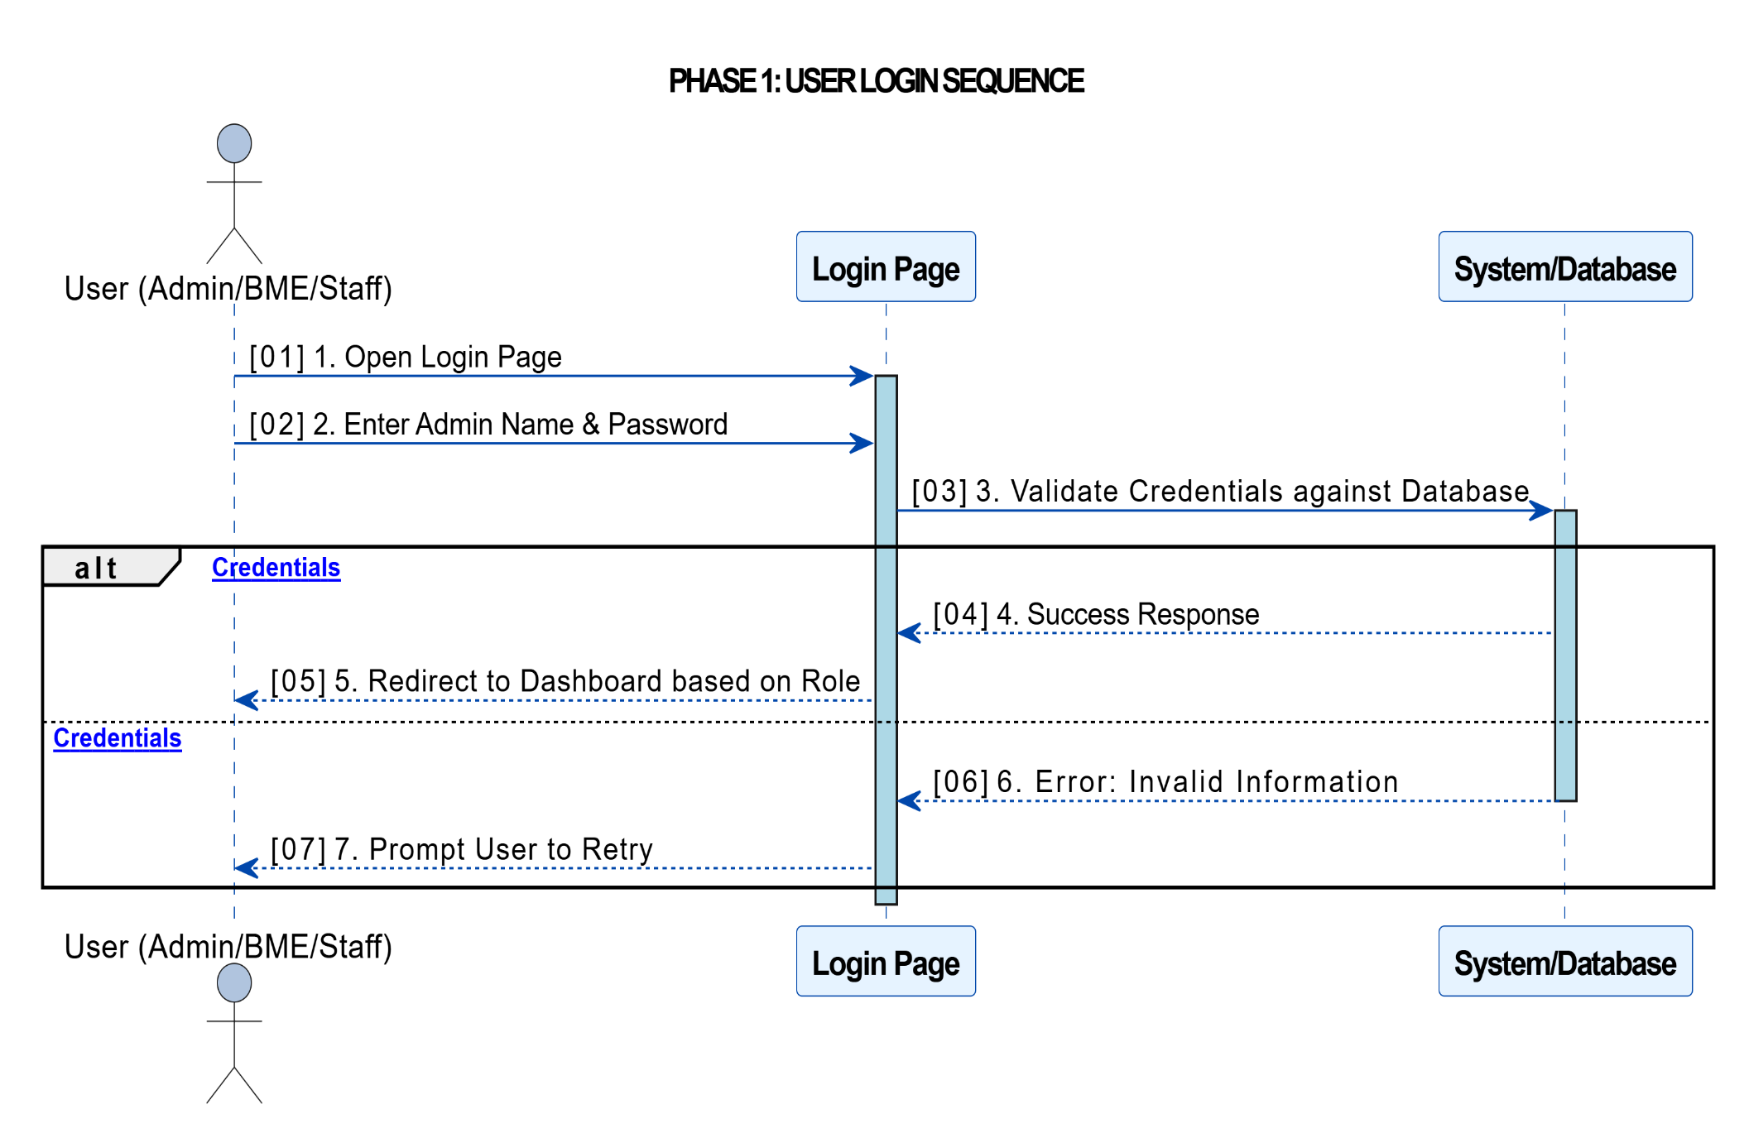
Sequence Diagrams

Slide 21
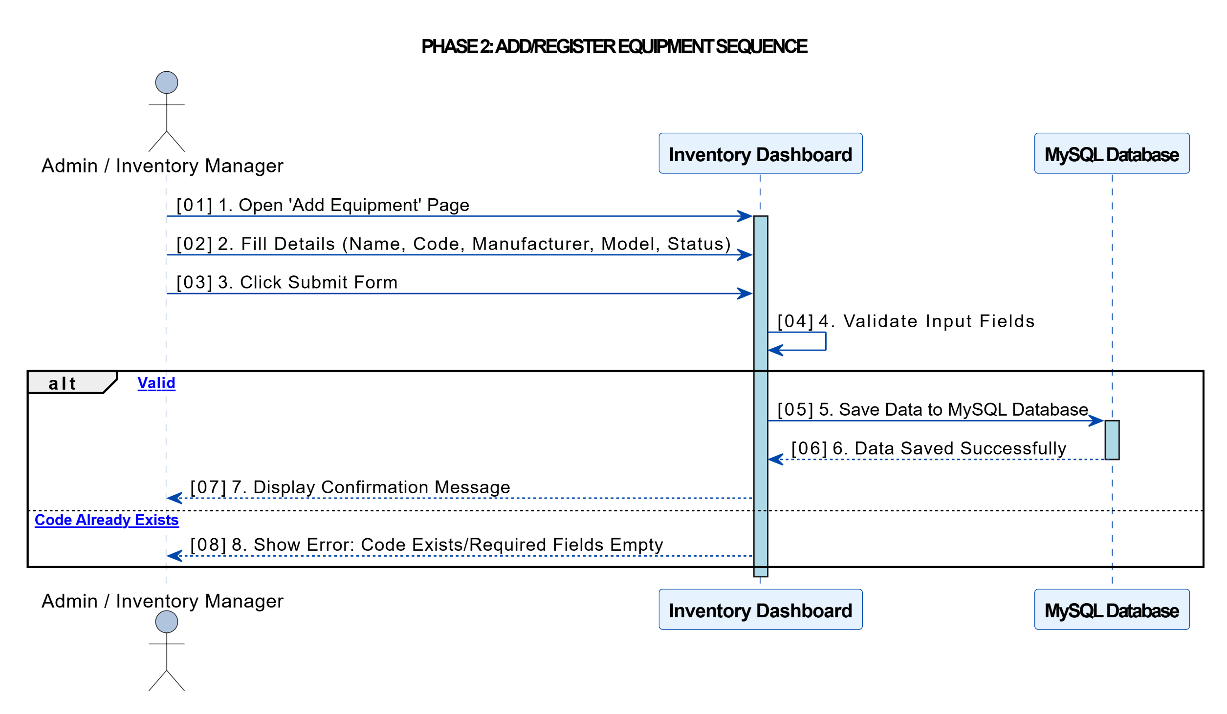
Sequence Diagrams Cont…

Slide 22
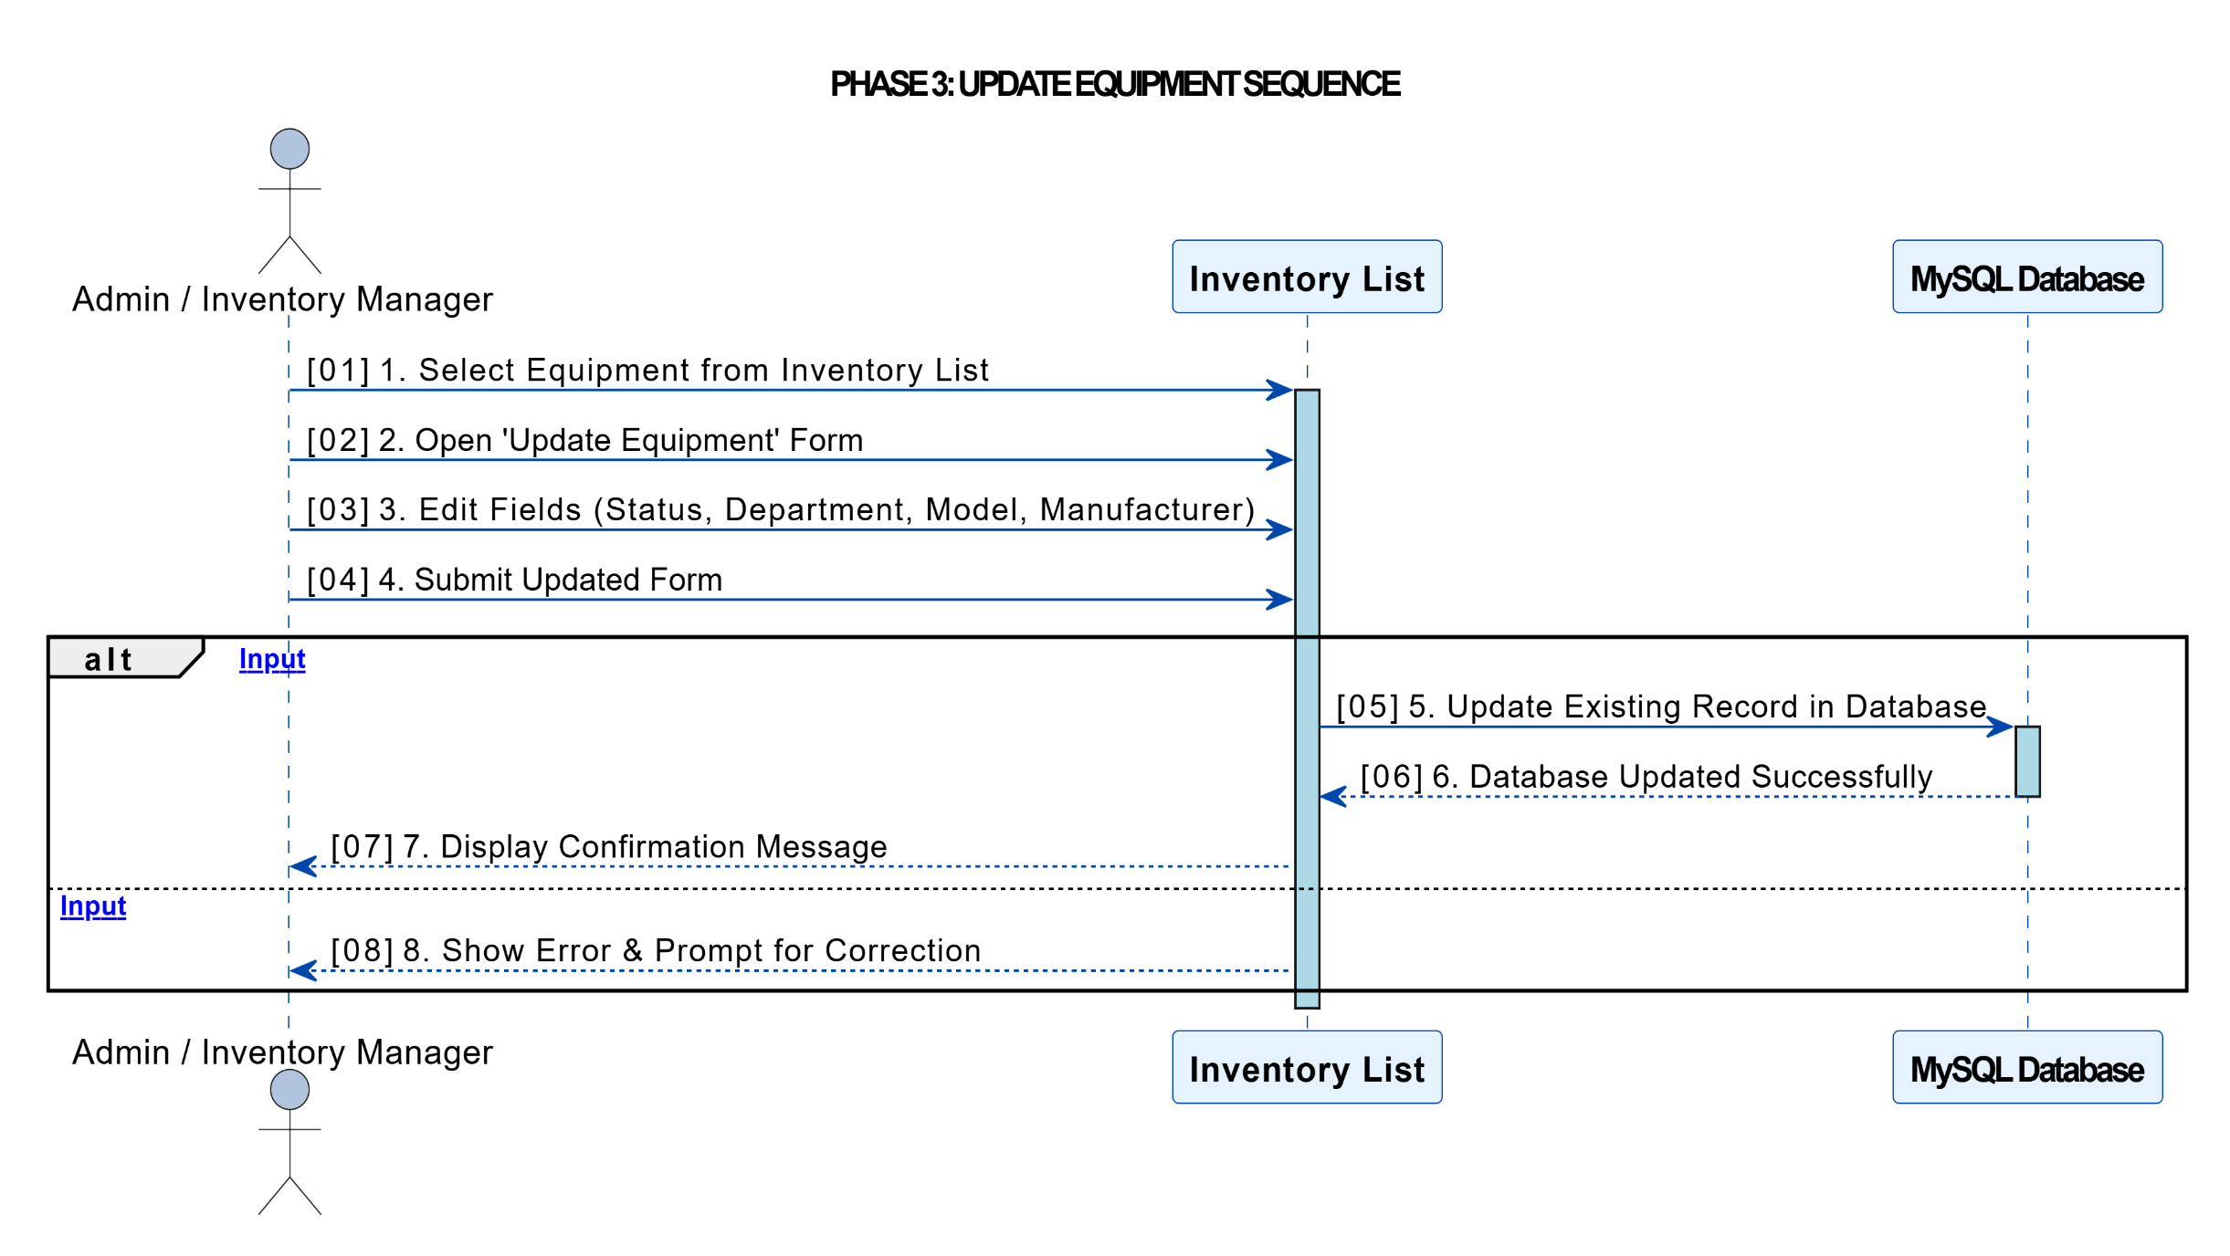
Sequence Diagrams Cont…

Slide 23
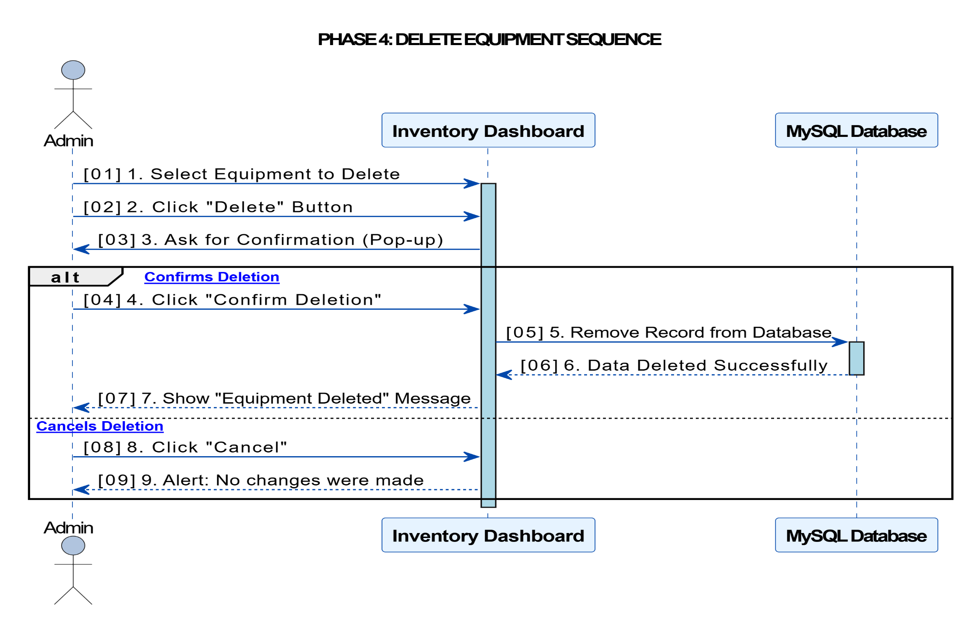
Sequence Diagrams Cont…

Slide 24
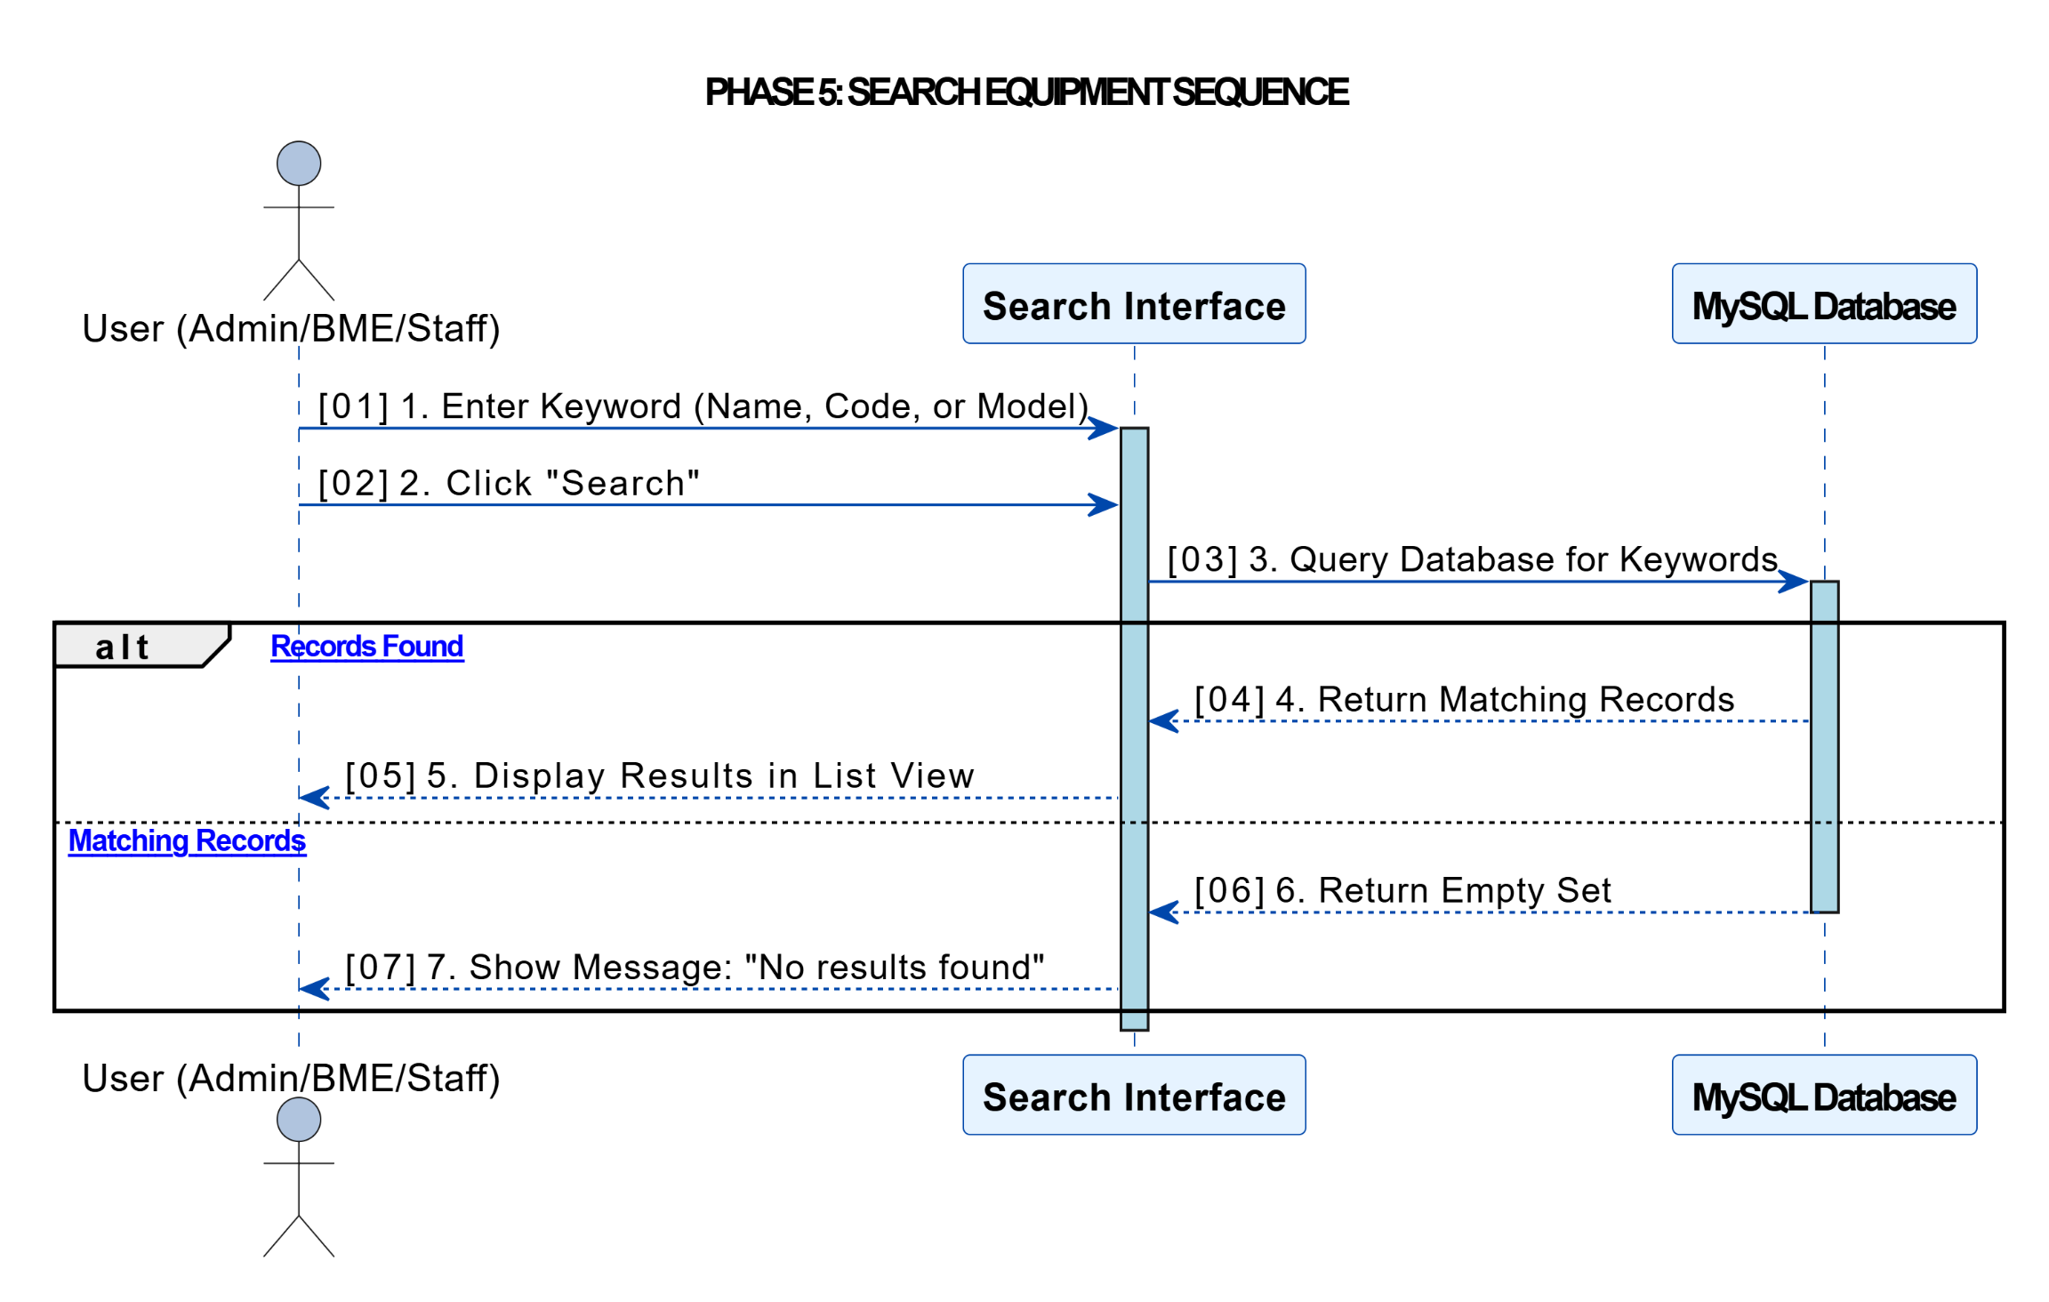
Sequence Diagrams Cont…

Slide 25
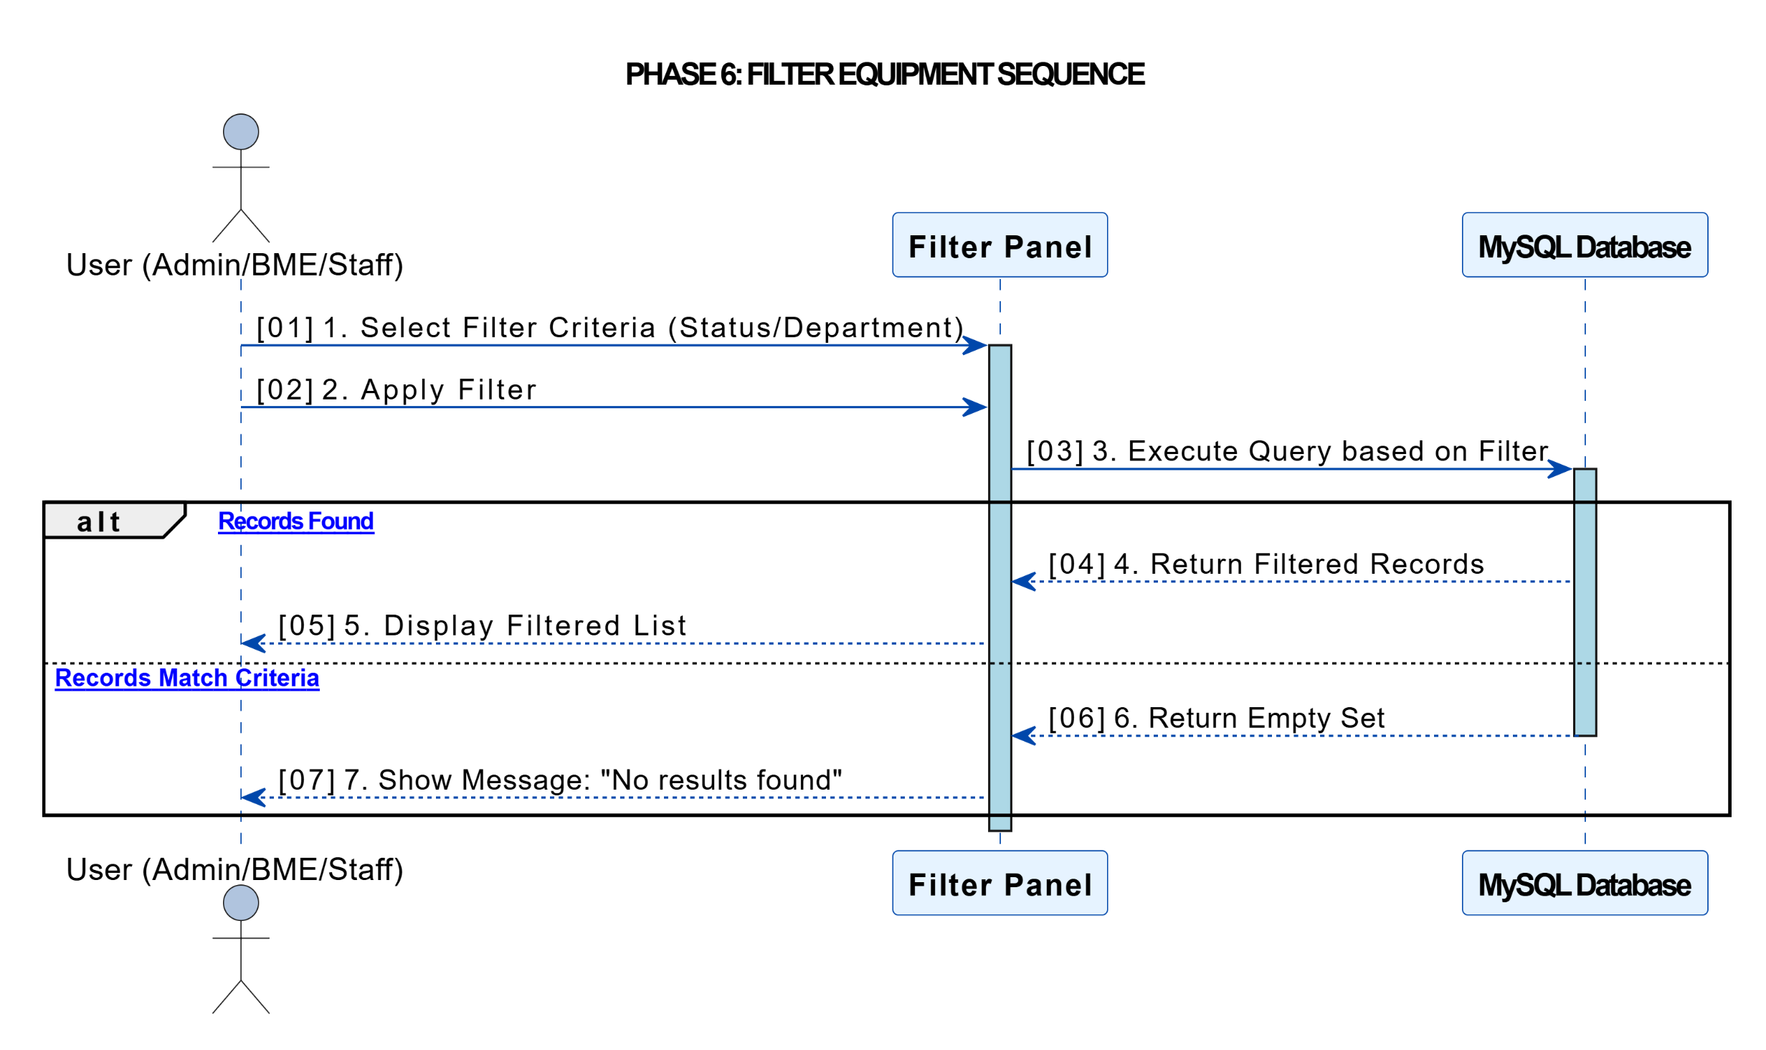
Sequence Diagrams Cont…

Slide 26
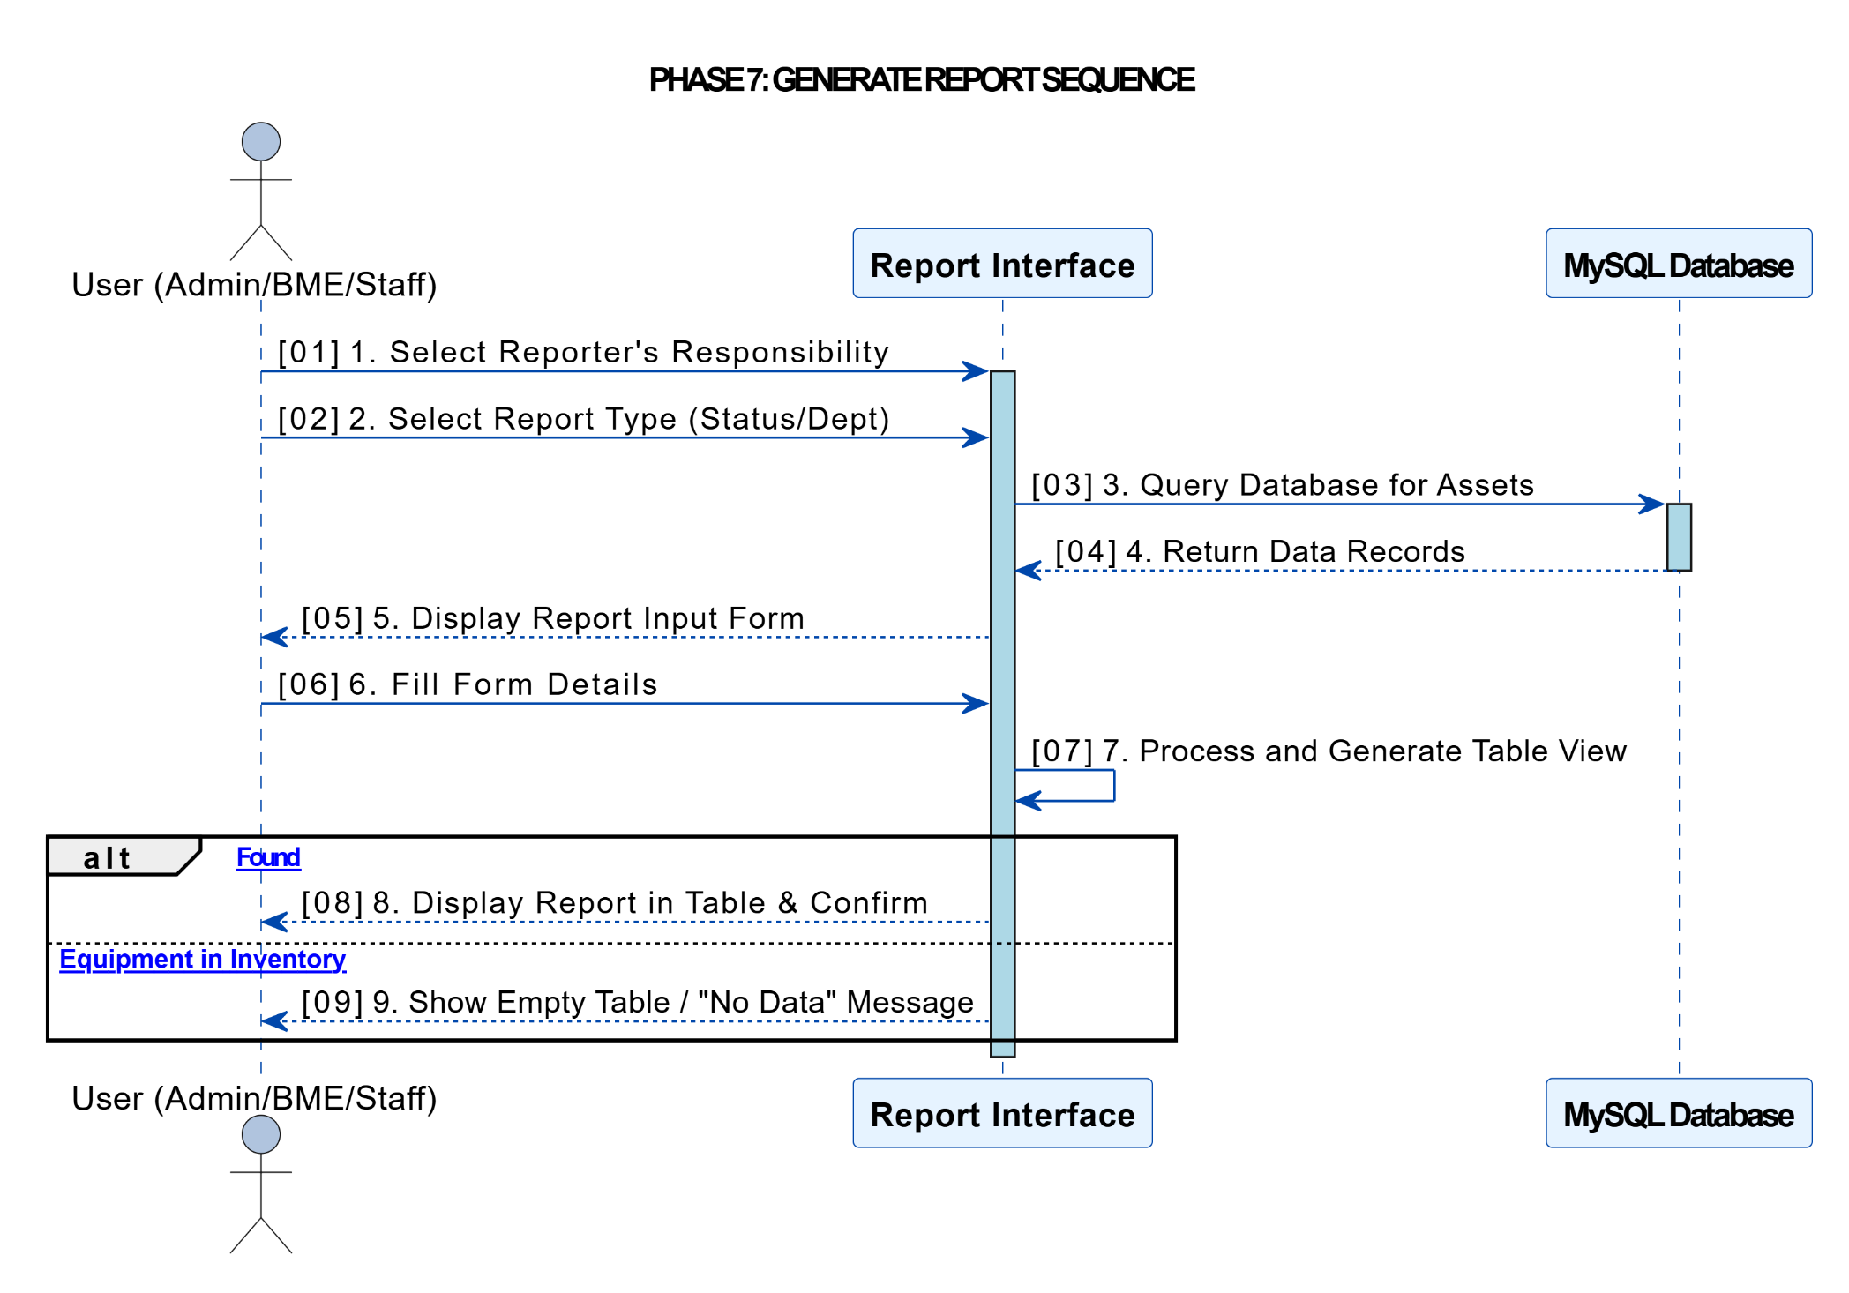
Sequence Diagrams Cont…

Slide 27
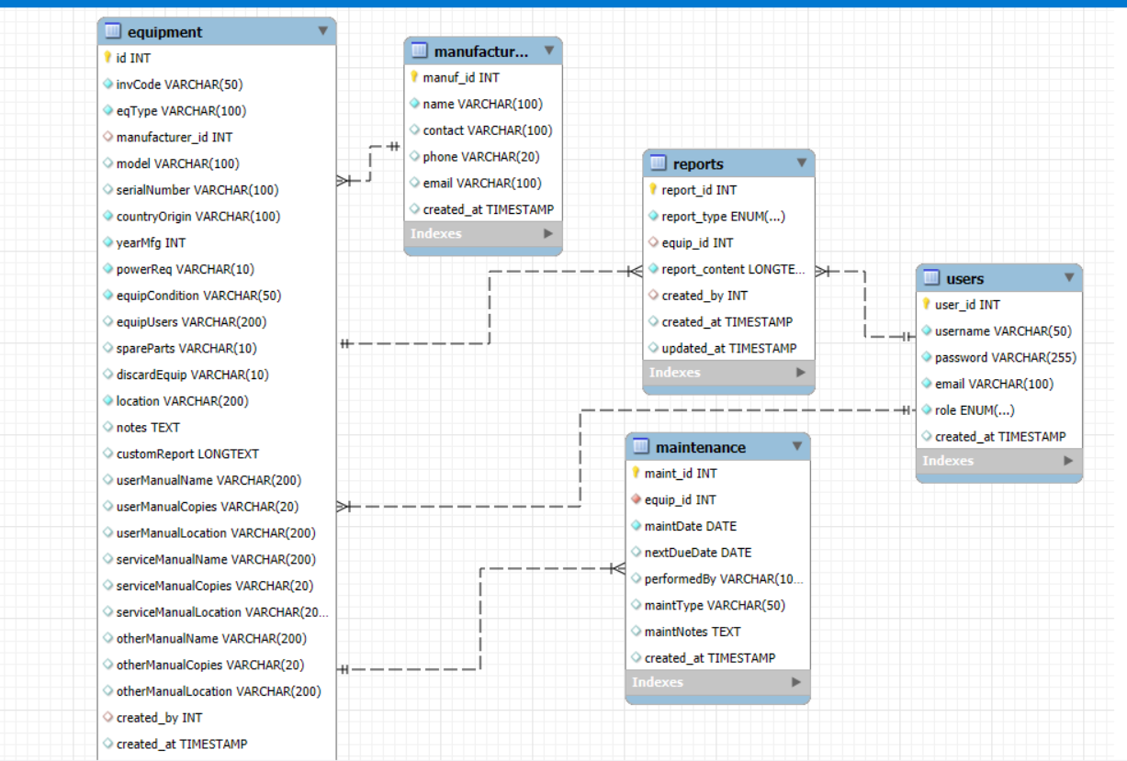
ER Diagram

Slide 28
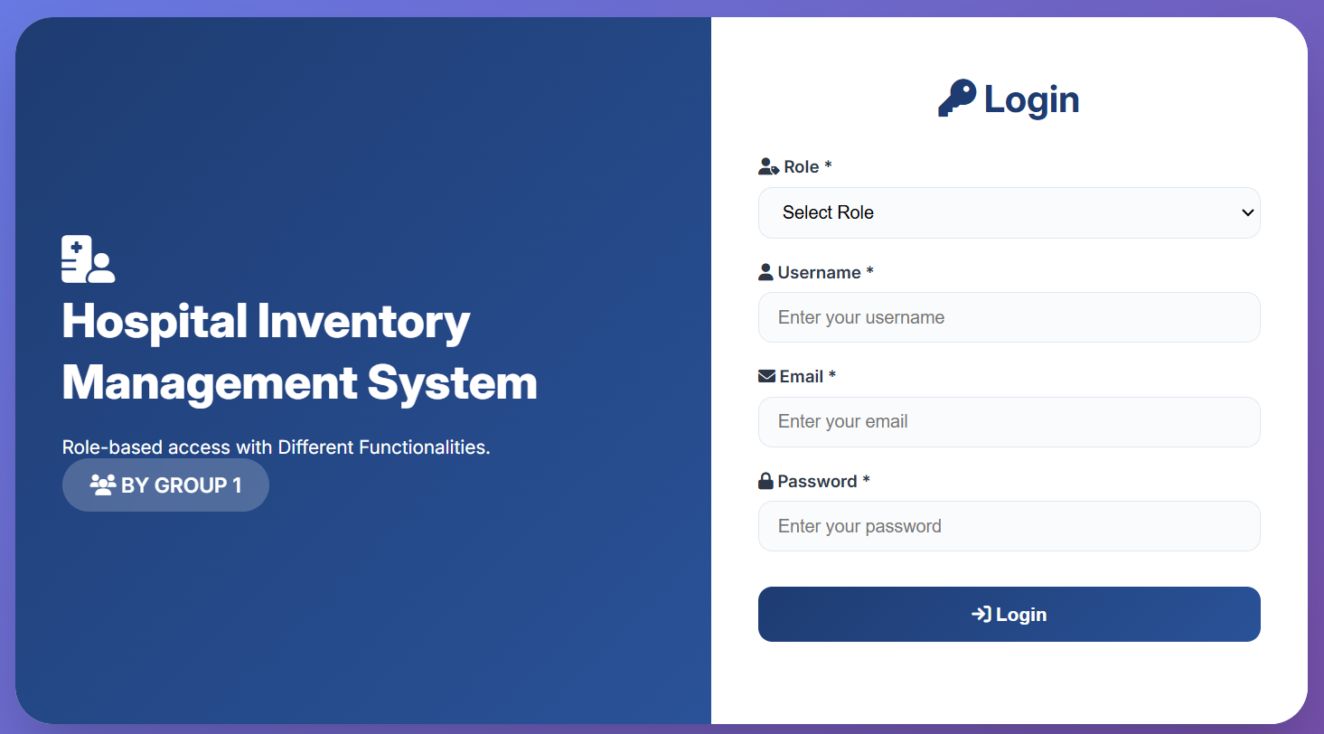
Login Page

Slide 29
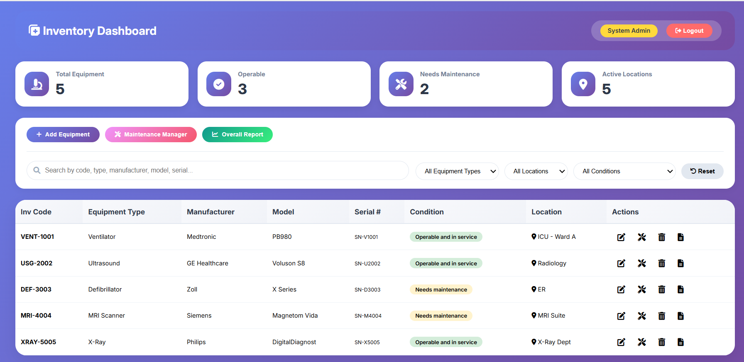
Dashboard

Slide 30
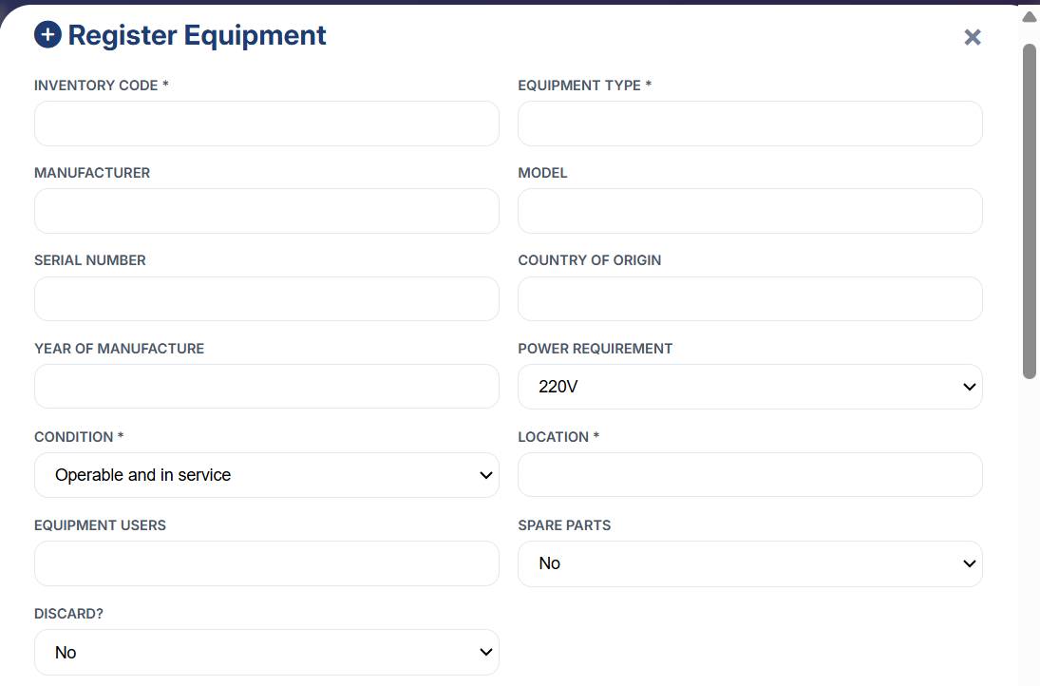
Sample Equipment Registration Form

Slide 31
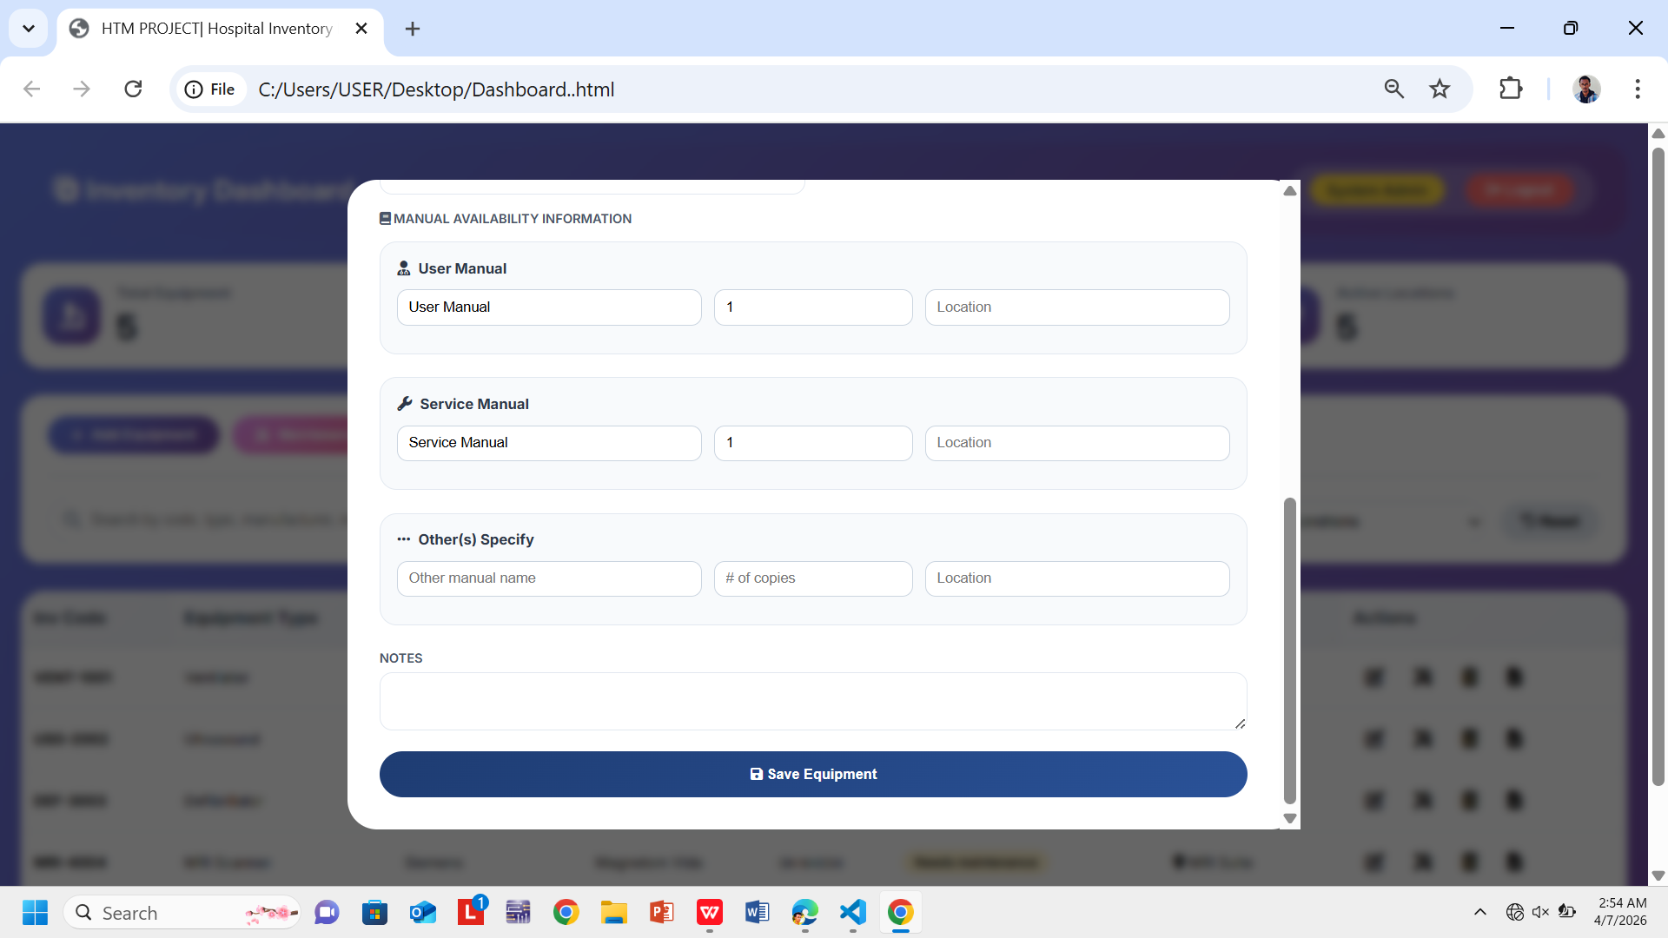
Cont...

Slide 32
THANK YOU!!!

